Slide 1

Rmagine By: Infinity Dream team

Slide 2
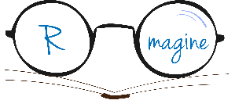
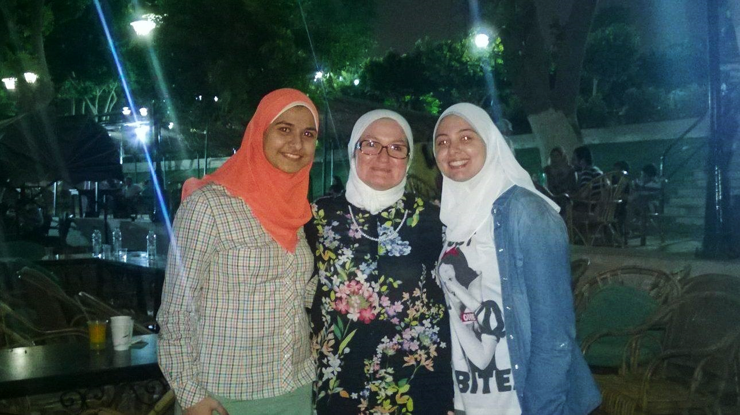
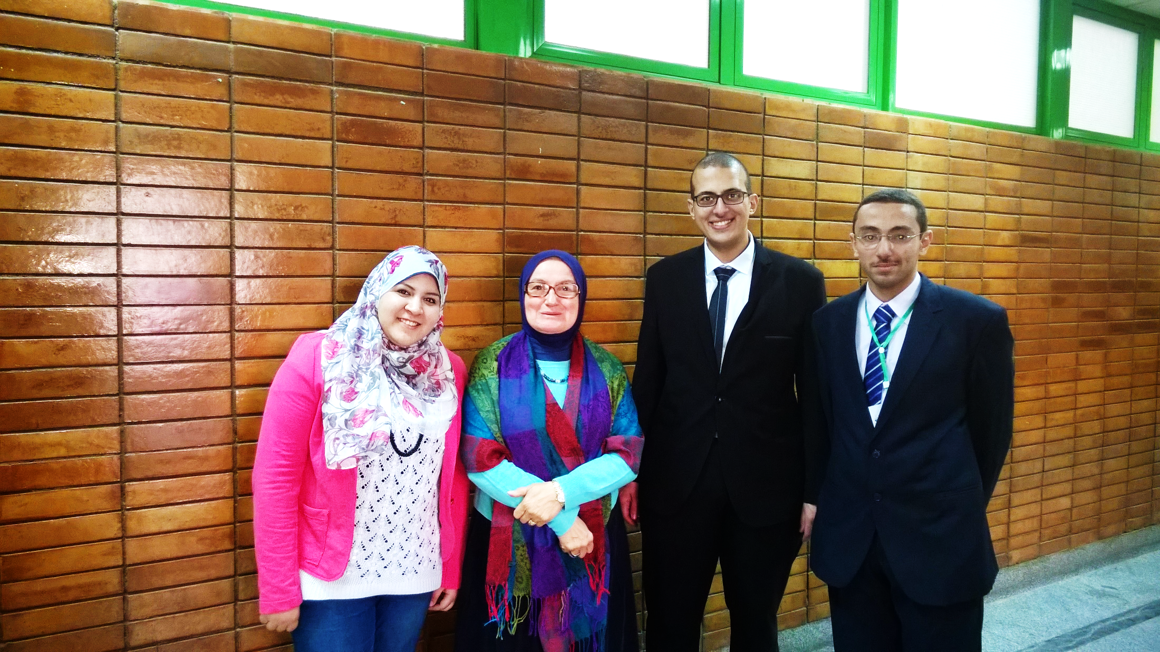
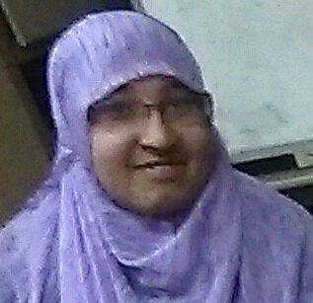
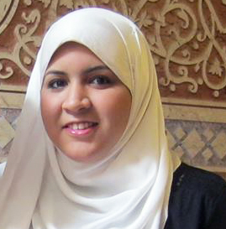
Meet our team!
Our Supervisor: Prof./ Magda Fayek
Ahmed El Zoughby
Alaa Sayed
Mohamed Mayla
Raneem Medhat
Notes:
Meet the team behind Rmagine. Infinity dream team from Cairo University.

Slide 3
Our Sponsor
Advanced
Technology
Labs
Cairo
Microsoft Research
Graduation Projects sponsorship 2014/2015 – NLP Track –
Notes:
Meet the team behind Rmagine. Infinity dream team from Cairo University.

Slide 4
Agenda
Project Idea & Motivation
System Overview
System Components
App Demo
Tools
Business Model
Time plan
Future Work

Slide 5

Imagining
Reading
Notes:
Rmagine is a windows phone 8.1 app that use the power of augmented reality and cloud technology to enhance the reading experience of novel readers.
By adding a 3d interactive layer to your everyday paper book, Rmagine will help you live your favorite stories and will make your books come to life.

Slide 6
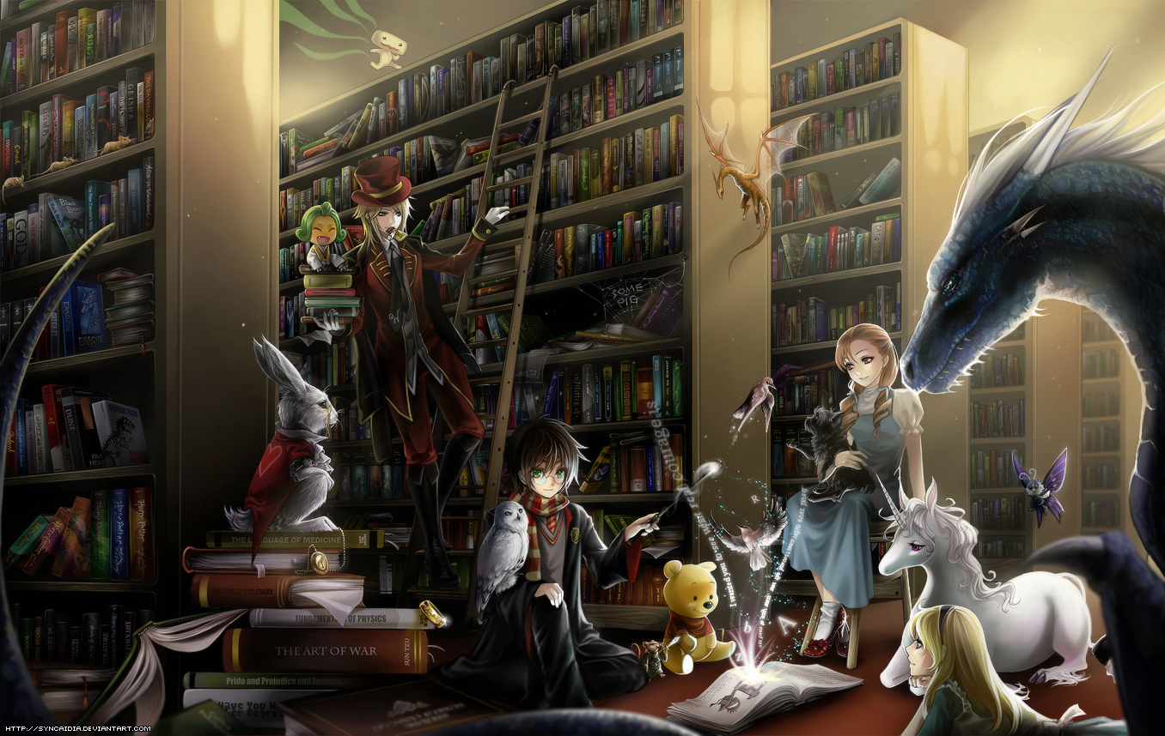
Problem/pain vs opp.
Notes:
Before we get started, let’s take a look at a flashback of one of my favorite childhood memories. I used to love reading when I was young. I was found of reading novels with a lot of adventures and fiction. It made me visit new worlds and live new experience. Life was always much more interesting inside of my head.

Slide 7
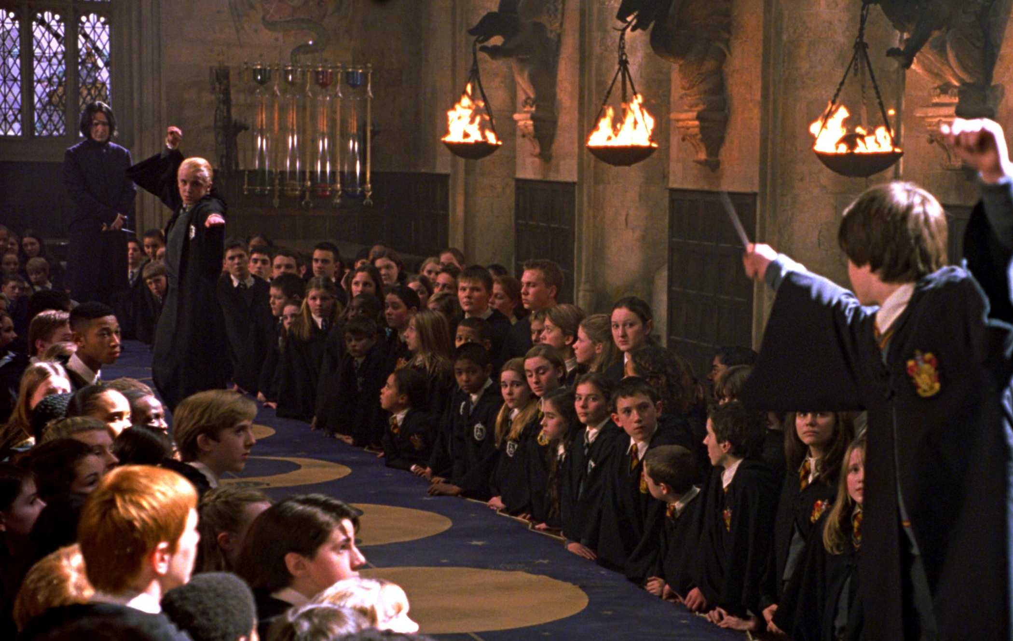
Problem/pain vs opp.
Notes:
One of my all time favorite novels is Harry Potter. Although I was young and my English wasn’t perfect I used to love reading Harry potter . This book always took me to a magical world I never imagined it could exist. I couldn’t wait for the movie to come out to see what I imagined in front of my eyes, to understand the scene I couldn’t get and to see my favorite characters in actions.

Slide 8
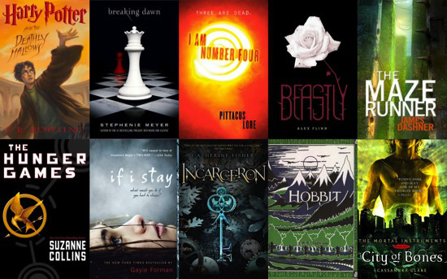
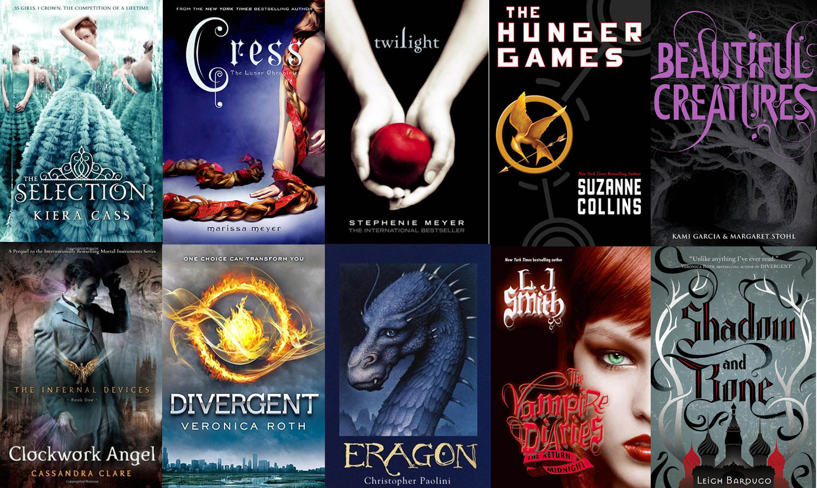
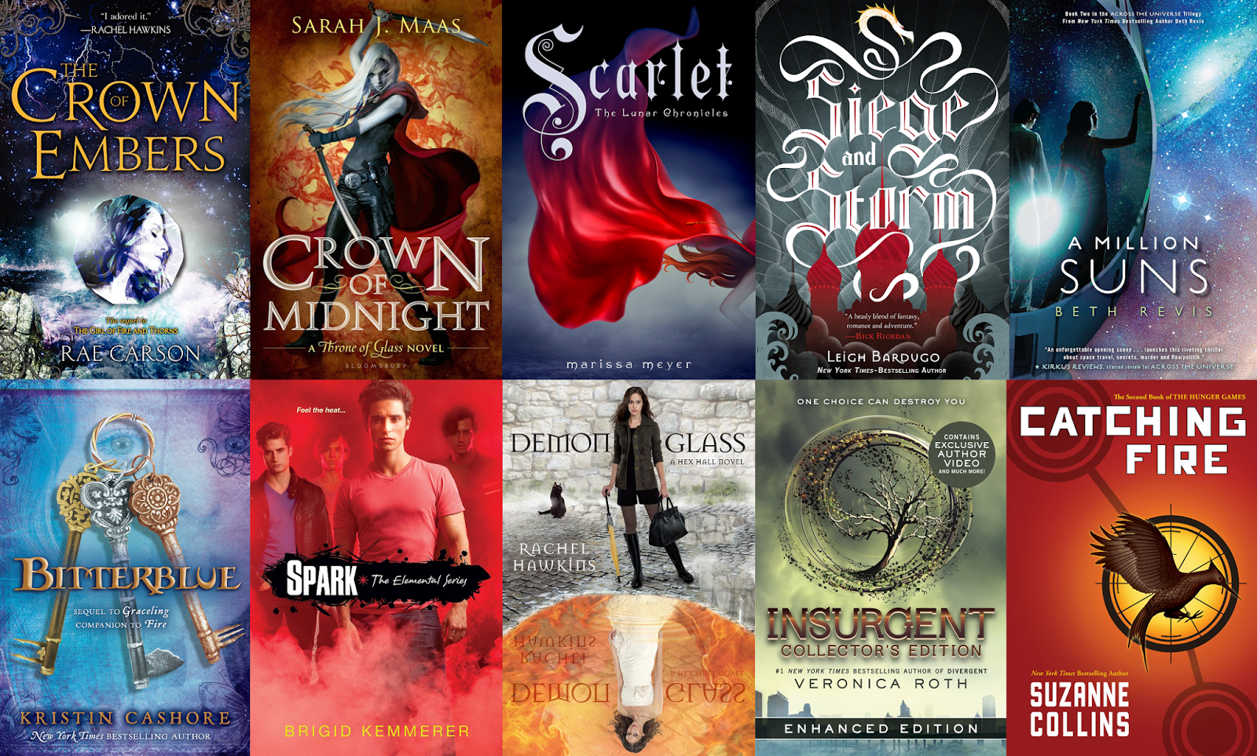
4.9% inc.
Book Sales
22.4% inc.
YA Category
Fiction
& Crime
Notes:
Coming back from that, nowadays the book publishing industry has flourished.
In 2014, total book sales increased by 4.9% and books published in YA category increased by 22.4% while Fiction & Crime remain on top of the favorite book genres out there.
Looking at this market we saw a huge opportunity arising and decided to combining our passion of technology with our love of reading to create Rmagine.

Slide 9


Meet Rmagine!
Text to Scene generation
Interactive
Layer
Augmented
Reality
Cloud based
Real-time
Translation &
Wiki search
Connection to
Goodreads
Notes:
Rmagine is a windows phone 8.1 app that offers text to scene conversion to make readers see their favorite lines coming to reality. It help you visualize the stories, actions and places you read about and make you dive more into reading.
It uses gestures with augmented reality and offer you a reader toolkit that enables you to translate any word, look it up in a dictionary, or even search for it on Wikipedia by just a simple touch on the word.
Rmagine connect you to a big network of readers to get the rating and reviews of any book via it’s integration with goodreads.
All of this uses the power of cloud technology to offer the readers a robust real-time service that will boost any reading experience.

Slide 10

System Overview

Slide 11

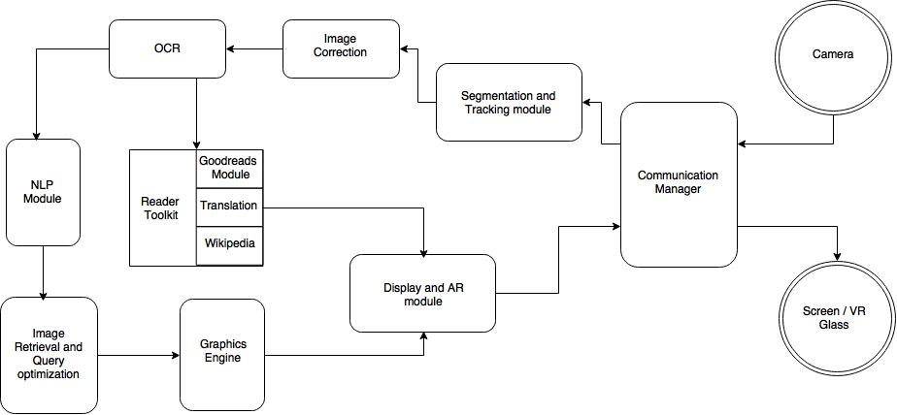

System Architecture
Client
Server

Slide 12
System Components

Slide 13
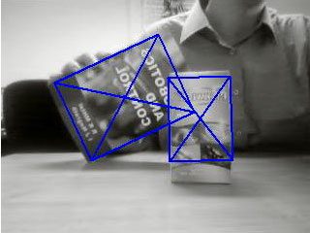
Segmentation & Detection
The segmentation and detection module is responsible of detecting the image of the book coming from the smartphone camera and do segmentation on it to focus on the page the user is reading.
Main Functions:
Apply canny edge detection and detect book edges.
Segment book using color segmentation.
Apply Hough transform to extract lines of the page.
Output a final cropped enhanced image of the page the user is reading.

Slide 14
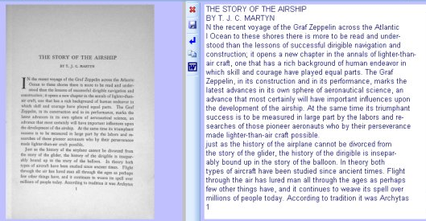
Tesseract OCR
The Tesseract OCR module is responsible of understanding the images of the book pages and getting the text the app need to start processing it.
Main Functions:
Read the book page image and extract the text inside it.

Slide 15
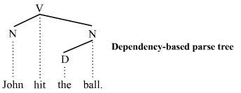
NLP Engine
The NLP module is responsible of understanding the text and extracting nouns, verbs and prepositions from the text.
Main Functions:
Split the text to several events
For each event generate parse tree and dependency graph
Get nouns, verbs and prepositions from each parse tree
Filter the directional prepositions from the prepositions
Traverse dependency graph to get prepositions and verbs relations to the nouns.

Slide 16

Image Retrieval
The Image retrieval module is responsible for searching for the keywords in each event to retrieve suitable images representing the scene objects of the final scene.
Main Functions:
Construct suitable search queries from the NLP output file to retrieve scene objects.
Uses Bing Search API to search for these queries and collect results.
Picks a relevant image from the search results and save it.
Prepares the scene objects list used by the graphics engine.

Slide 17
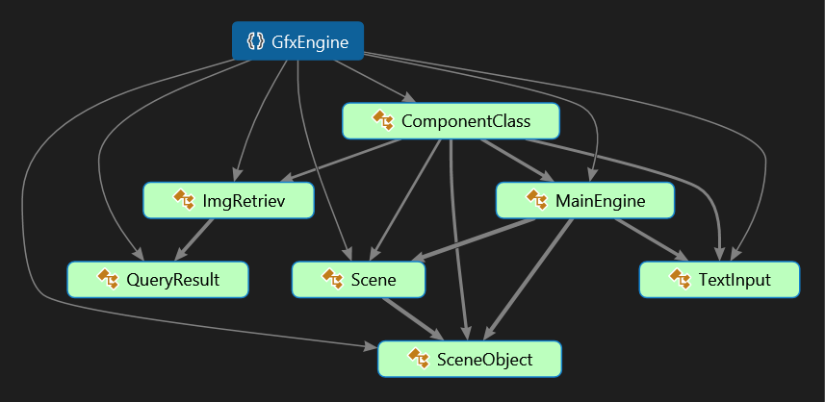
Graphics Engine
The graphics engine is responsible for resizing and positioning the scene objects to be displayed in the final scene.
Main Functions:
Resize object based on categories and prior knowledge.
Position object based on default positions and prior knowledge.
Organize objects in final scene using spatial relations represented in a scene graph.
Prepare final output to be passed to the Display module.

Slide 18



Reader Toolkit
Goodreads Translator Wikipedia

Slide 19
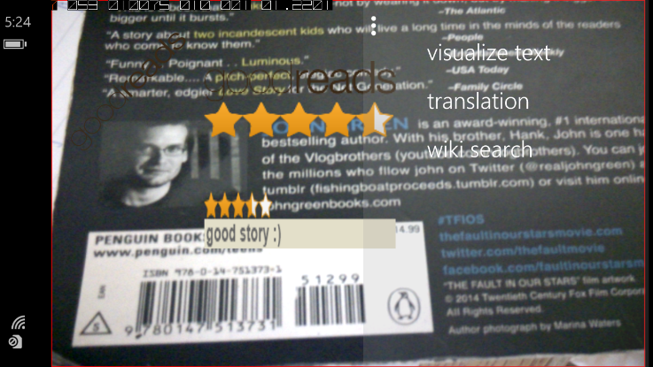
Display & VR module
The display and VR module is responsible of preparing the output of each module for display and send images ready to be displayed to the client.
Main Functions:
Prepare the output of Goodreads for display
Prepare the output of the translator for display
Prepare the output of the Wikipedia for display

Slide 20
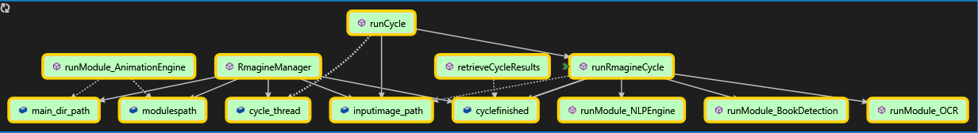
Communication Manager (Server)
The communication manager module responsible for communicating with the clients and with modules with each other.
Main Functions:
Retrieve images from clients.
Detect and read text from pages and generate graphics representing the text in it.
Send the graphics to the client.

Slide 21
Video & Demo

Slide 22


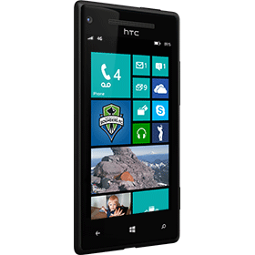


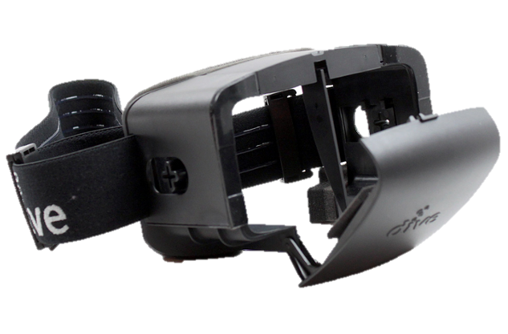

Tools

Slide 23
Business Model

Slide 24

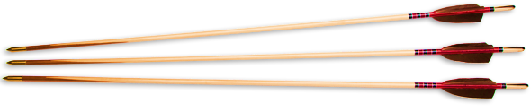

Customers & Potential Market
$590.2 Million
Sci Fiction/ Fantasy
$728.2 Million
Crime / Mystery
Age
Group
$1311.9 Million
Children/ Young Adults
20 Million Users
Notes:
As we said we are talking about a huge market. Let’s first see some statistics. (Reading and demonstrating the numbers in order)
Our target customers are the intersection between the following:
- Windows phone 8.1 users
- Novel readers age 15 to 35
- Goodreads users
- Fiction/Crime/YA genre fans
--------------------------------
What we offer to our customers is as follow:
- Visualization …whenever possible
- Offering a comprehensive toolkit to enhance your reading experience.
- Offering pre-rendered/customized animation for your favorite top selling book that we will explain in the next slide.

Slide 25

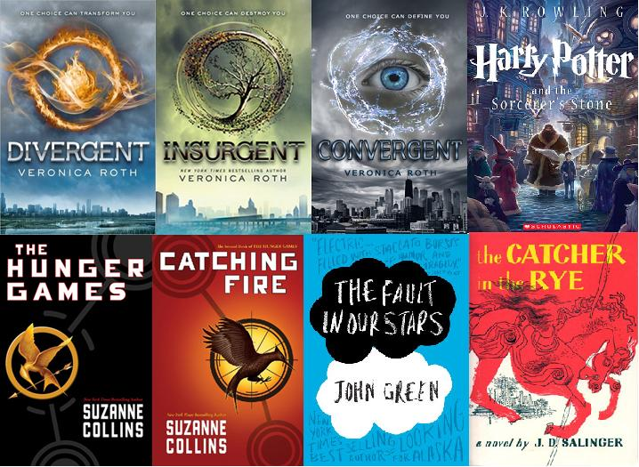


Revenue Streams
Key Partners
Authors
Publishers
In App
Purchase
Notes:
So how will we make money and ensure the sustainability of our project?
Our key feature as mentioned is converting text into graphics that represent the story happening in these lines.
To promote the app we will create some pre-rendered graphics (not fully automated and revised by humans) (supervised) for some of the top selling novels to offer for free to our readers as a start. After that we will select some other popular books and create graphics also for them.
We will then sell a one time use ticket that contains a QR code. These tickets gives our users access to pre-rendered graphics for a certain book (depending on the ticket by simply scanning it. Users can also purchase our graphics via amazon or inside the app itself using in App purchase.
Our app will still perform text to scene conversion for free for all these books, but the conversion we offer is unsupervised by humans, unlike the graphics we will sell that will be much more enhanced for an engaging visualization experience.
This service can also be done in partnership with authors and publishing houses to promote new publishes as well.

Slide 26
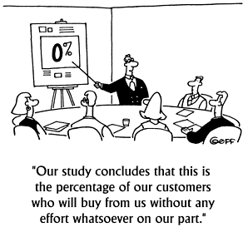



Channels
Notes:
We will advertise for our app and reach our customer through 4 main channels.
Goodreads ads will be used to publicize for our app and our new tickets, also the integration with goodreads will promote the app among their users and we plan in the future to add more features that will enable the user to use more goodreads features directly from our app.
Targeted Facebook ads for our services will enable us to reach fiction readers easily. Facebook ads will be even more useful when we are publishing graphics for a new book, because we can easily target the users interested in this book.
We will also use amazon for targeted ads and for selling our tickets along with famous book stores. The bookstores will play a big role in our initial promotion we mentioned earlier as well.

Slide 27
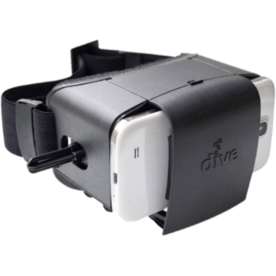

Cost Structure
Windows Phone 8.1
(Dev)
Azure Hosting
Supervised
learning /
Pre-rendered graphics
VR Glasses
Advanced
Technology
Labs
Cairo
Microsoft Research
Notes:
The price of our services will be based on the following:
- 1 windows phone 8.1 device for developing the app ( The cost of this phone is covered by the sponsorship of Microsoft ATLC)
- VR glass cost (around 30 euros), this is an optional cost but we prefer that our users purchase it to get the full experience.
- Azure hosing cost
- Pre-rendered graphics & supervised learning cost.

Slide 28
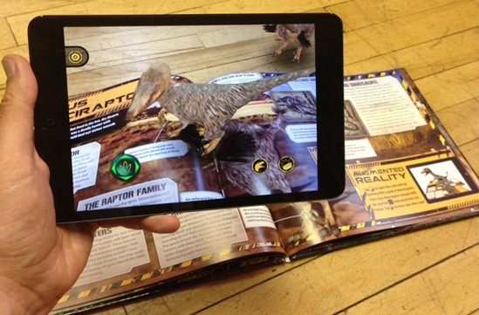
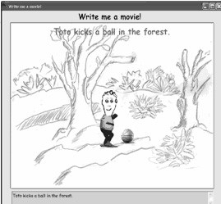
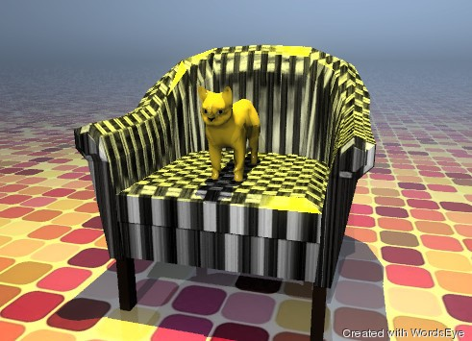
Market Survey
IDinasour
NLP Story maker
Words Eye
Notes:
We did some market research and we found 3 projects that share some similarities with us, yet our project remains unique.
1- IDinasour:
A phone app that detects QR codes in IDinasour books and generate pre-saved graphics in augmented reality. (No text processing, limited set of models, works only on IDinasour books)
2- NLP Story maker:
A research project, and not a product It was done by Microsoft Research to convert stories into graphics using a graphics library. The actors must be defined in the beginning of the story. (Strong text processing, not a product, actors must be defined, pre-defined graphics.. )
3- WordsEye
A project that will be released soon. Converts descriptive high detailed text into a scene accurately. (Pre-saved models, not an app, text must be very descriptive, no augmented reality)

Slide 29
Timeline

Slide 30
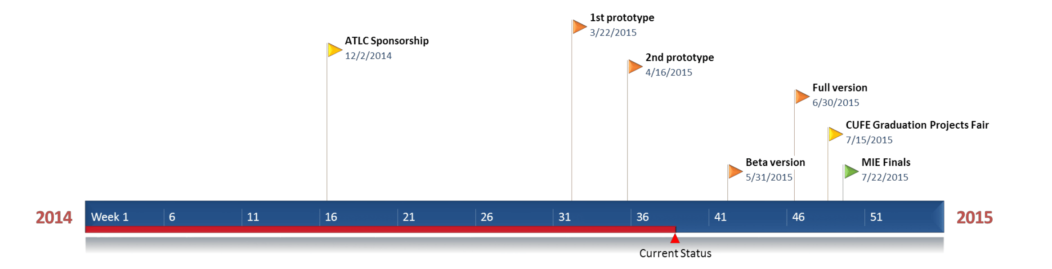
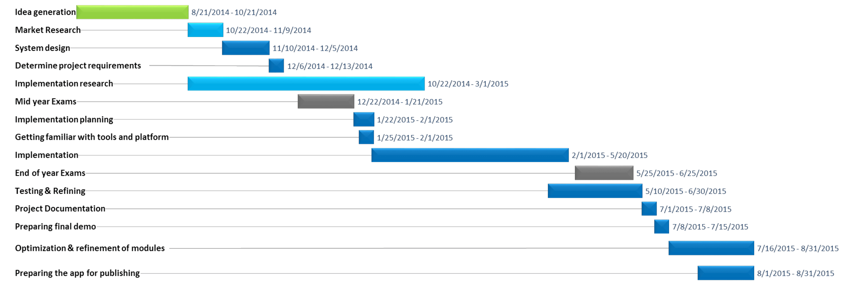

Slide 31
Future work

Slide 32
Future work
Advanced text processing & understanding
Complex scene templates & graphs
Prior knowledge learning agents
3D scenes
Gesture recognition
Further Goodreads integration
Modules Development

Slide 33
Future work
Made In Egypt (MIE)
Egyptian Engineering Day (EED)
Ibtecar 2015
Competitions & Activities

Slide 34

It’s time to Rmagine!
Notes:
This was all for today, we hope you enjoyed our ride with Rmagine. A quote we would like to end said in one of our favorite books Alice in wonderland by Alice : “Sometimes I believe in as many as six impossible things before breakfast.” we invite you to imagine with us because everything you can imagine can one day be real.

Slide 35
Thank You ☺!
Notes:
Thank you!

